Slide 1

Introduction to Computer Systems
Information Representation
Direct Link to view these slides on Google Docs

Slide 2
What to expect in this topic:
Information Representation
Binary, Integer and Character Representation - ASCII and EBCDIC
Number system
Number systems conversion
– Decimal and Binary conversions
– Octal and Hexadecimal conversions

Slide 3
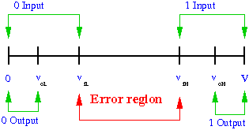
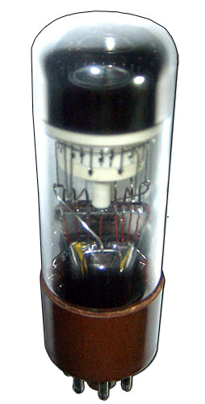
Information Representation
Engineering considerations mean that two state devices are more reliable.
Some early computers used dekatrons - valves with 10 states - effectively represented by 10 bits!
Use electrical voltages or magnetic polarity to represent data
Modern systems always use binary system
Representation uses binary digits - bits (0, 1)
Dekatron
For more information on representing numbers and letters with binary, please visit: https://www.youtube.com/watch?v=1GSjbWt0c9M

Slide 4
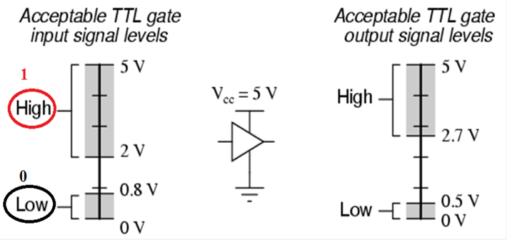
Logic Signal Voltage Levels
Error Region: If a voltage signal ranging between 0.8 volts and 2 volts were to be sent into the input of a TTL gate, there would be no certain response from the gate.

Slide 5
Binary Representation
Binary representation - base 2 numbers, consisting of only 0 and 1 bits - similar to decimal using powers of 10
Each bit position represents an increasing power of 2 (from right to left)
i.e. 100111₂ = 1 x 2⁵ + 0 x 2⁴ + 0 x 2³ + 1 x 2² + 1 x 2¹ + 1 x 2⁰
= 32 + 4 + 2 +1
= 39
N bits can represent values from 0 to 2^{N} -1
Sets of 8 bits form a byte - values from 0 to 255
Words formed from sets of bytes - can be 16 bits (2 bytes), 32 bits (4 bytes) or 64 bits (8 bytes) depending on the machine

Slide 6
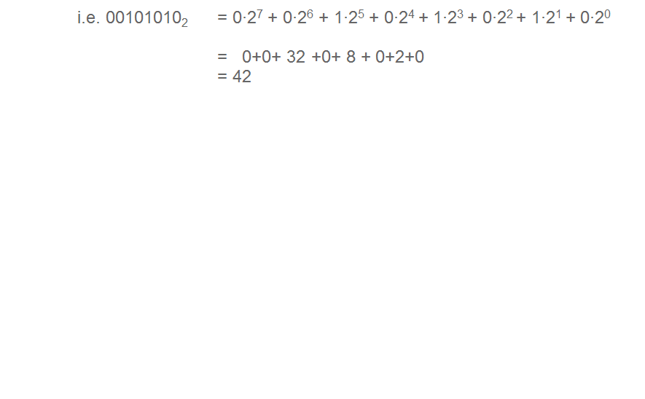
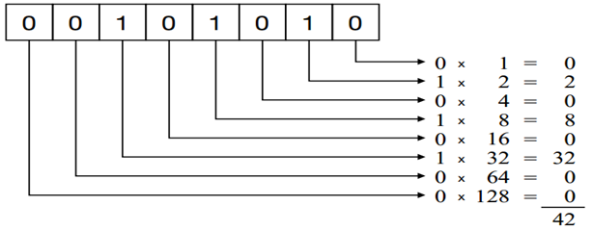
Binary Representation

Slide 7
Decimal (Base 10) | Binary (Base 2) | Octal (Base 8) | Hexadecimal (Base 16)
0 | 0000 | 0 | 0
1 | 0001 | 1 | 1
2 | 0010 | 2 | 2
3 | 0011 | 3 | 3
4 | 0100 | 4 | 4
5 | 0101 | 5 | 5
6 | 0110 | 6 | 6
7 | 0111 | 7 | 7
8 | 1000 | 10 | 8
9 | 1001 | 11 | 9
10 | 1010 | 12 | A
11 | 1011 | 13 | B
12 | 1100 | 14 | C
13 | 1101 | 15 | D
14 | 1110 | 16 | E
15 | 1111 | 17 | F
16 | 10000 | 20 | 10
As well as binary there is also octal - base 8 and hexadecimal - base 16
Often used as notation as easy to convert between octal and binary or hexadecimal and binary.

Slide 8
Information Representation
How does computer interpret a bit pattern such as
00000010 00110010 10100000 00100000₂
02 32 A0 20₁₆
Depends on how computer wants to use it
As 4 ASCII characters
As 2 16 bit integers
As a 32 bit integer
Other interpretations would be possible, e.g. Floating point number, Unicode characters etc.

Slide 9
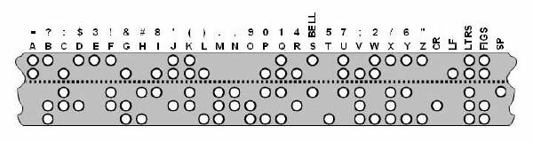
Character Representation
Early teleprinters used Baudot code – based on 5 hole paper tape – 32 possible characters
These need SHIFT codes to switch between lower and upper case, and numerics

Slide 10
Binary Coded Decimal
Decimal | Binary | BCD
0 | 0000 | 0000
1 | 0001 | 0001
2 | 0010 | 0010
3 | 0011 | 0011
4 | 0100 | 0100
5 | 0101 | 0101
6 | 0110 | 0110
7 | 0111 | 0111
8 | 1000 | 1000
9 | 1001 | 1001
10 | 1010 | 0001 0000
11 | 1011 | 0001 0001
12 | 1100 | 0001 0010
13 | 1101 | 0001 0011
14 | 1110 | 0001 0100
15 | 1111 | 0001 0101
Simplest Binary Code for Decimal Digits
Only encodes 10 digits from 0 to 9
BCD is a weighted code
The weights are 8,4,2,1
Same weights as a binary number
There are six invalid code words
1010, 1011, 1100, 1101, 1110, 1111
Example on BCD Coding
13 ⇔(0001 0011)_{BCD}

Slide 11
Character Representation - ASCII
American Standard Code for Information Interchange (ASCII) originally 7 bits – 128 characters
ASCII | Represents | ASCII | Represents | ASCII | Represents
0 | NUL | 48 | 0 | 96
1 | SOH | 49 | 1 | 97 | a
2 | STX | 50 | 2 | 98 | b
32 |  | 64 | @ | 122 | z
33 | ! | 65 | A | 123 | {
45 | - | 90 | Z | 125 | }
46 | . | 91 | [ | 126 | ~
47 | / | 92 | \ | 127 | DEL
Digits precede alphabetics
Alphabetic characters contiguous
Gap between upper and lower case is 32 - single bit conversion between cases
Digits converted by subtracting 48
Link to Full ASCII Lookup Tables http://www.asciitable.com/

Slide 12
Character Representation - Later developments
There are lots of ISO standards (International Standards Organisation)
These are two examples of relevant ISO standards.
ISO-8859
ASCII extended to 8 bits – variety of uses for upper 128 characters
Latin 1 includes most European language characters including accents, such as ß, ç, ö, Ł etc.
PC supports different code pages for different languages
UNICODE
Originally 16 bit representation, now 32 bits
First 127 identical to ASCII
Other value ranges for Chinese, Tamil, Korean, etc need many more character values than European languages
Has invented character sets for Deseret (phonetic alphabet), Shavian, but not for Tolkien's Elvish (or Klingon?)

Slide 13
Decimal to Binary Conversion (First Method)
Repeatedly find the largest power of 2 less than the number to convert
Set corresponding bit, subtract power of 2 and repeat using the remaining number until remaining number is 0
Example: 217
*Remember that rightmost bit is two to the power of 0
Number | Power of 2 | Value of power | Bit | Accumulated Binary
217 | 2⁷ | 128 | 1000 0000 | 1000 0000
89 | 2⁶ | 64 | 0100 0000 | 1100 0000
25 | 2⁴ | 16 | 0001 0000 | 1101 0000
9 | 2³ | 8 | 0000 1000 | 1101 1000
1 | 2⁰ | 1 | 0000 0001 | 1101 1001

Slide 14
Decimal to Binary Conversion (Second Method)
Repeatedly
Divide number by 2 and record remainder
Until 0 reached
Result is remainders read in reverse order
Example: 217
Result is 1101 1001
Number | Halved | Remainder
217 | 108 | 1
108 | 54 | 0
54 | 27 | 0
27 | 13 | 1
13 | 6 | 1
6 | 3 | 0
3 | 1 | 1
1 | 0 | 1

Slide 15
Binary to Decimal Conversion (First Method)
For each bit in number, identify power of two (count bits from right starting at 0) and if 1 add corresponding value
Example: 0001 0100 0110
Bits | Bit | Value | Accumulated
0001 0100 0110 | 8 | 256 | 256
0001 0100 0110 | 6 | 64 | 320
0001 0100 0110 | 2 | 4 | 324
0001 0100 0110 | 1 | 2 | 326
Result is 326

Slide 16
Integer Representation
Binary representation – base 2 numbers, consisting of only 0 and 1 bits
Each bit position represents an increasing power of 2 (from right to left)
100111₂ = 1∙2⁵ + 0∙2⁴+ 0∙2³+ 1∙2²+ 1∙2¹+ 1∙2⁰
= 32 + 4 + 2 +1
= 39
n | 0 | 1 | 2 | 3 | 4 | 5 | 6
2^{n} | 1 | 2 | 4 | 8 | 16 | 32 | 64
n | 7 | 8 | 9 | 10 | 11 | 12 | 13
2^{n} | 128 | 256 | 512 | 1024 | 2048 | 4096 | 8192
n | 14 | 15 | 16 | 17 | 18 | 19 | 20
2^{n} | 16384 | 32768 | 65536 | 131072 | 262144 | 524288 | 1048576

Slide 17
Binary to Decimal Conversion (Second Method)
Initialise value to 0
Starting from most significant bit (leftmost bit)
Multiply value by 2 and add bit
Move to next bit
Example: 0001 0100 0110
Result is 326
Original | Bit | Value | New value
0001 0100 0110 | 1 | 0 | 1
0001 0100 0110 | 0 | 1 | 2
0001 0100 0110 | 1 | 2 | 5
0001 0100 0110 | 0 | 5 | 10
0001 0100 0110 | 0 | 10 | 20
0001 0100 0110 | 0 | 20 | 40
0001 0100 0110 | 1 | 40 | 81
0001 0100 0110 | 1 | 81 | 163
0001 0100 0110 | 0 | 163 | 326

Slide 18
Octal and Hexadecimal Conversions
Conversion of octal to and from decimal is done similarly
Successively divide by 8, recording remainders
When 0 reached, octal value is remainders in reverse
139 ÷ 8 = 17 remainder 3
17 ÷ 8 = 2 remainder 1
2 ÷ 8 = 0 remainder 2
hence 139₁₀ = 213₈
Hexadecimal works the same, except using 16
139 ÷ 16 = 8 remainder 11 (B)
8 ÷ 16 = 0 remainder 8
hence 139₁₀ = 8B₁₆

Slide 19
Information Representation - Summary
All information represented ultimately by bits
Values 0 or 1 in computers
Grouping bits together into bytes, words, or larger collections allows larger range of values
Interpretation of groups of bits depends entirely on context

Slide 20
Credits
Dekatron by I, Hellbus is licensed under the Creative Commons Attribution-Share Alike 3.0 Unported license.

